Slide 1

Race Vision

Slide 2

Description
RaceVision is a deep learning pipeline for lap-by-lap prediction of Formula 1 races.
It uses historical race data from the Ergast Motor Racing Database to build time-series datasets and trains an LSTM model to forecast driver positions, lap times, and pit-stop events for all 20 grid starters.

Slide 3
Files structure
RaceVision/
├── scripts/
│ ├── 1-DataPreparation.py # Converts raw Ergast DB CSVs to per-race/lap CSVs
│ ├── 2-RacePredictionPipeline.py # Builds embeddings, .npy datasets, and defines & trains LSTM model
├── db/ # Raw and processed data directory (user‐specified)
│ ├── races.csv # Metadata: race calendar
│ ├── lap_times.csv # Raw lap‐time logs
│ ├── results.csv # Race results per driver
│ ├── qualifying.csv # Qualifying session times
│ ├── pit_stops.csv # Pit‐stop events (from 2012)
│ ├── driver_standings.csv # Championship standings per round
│ ├── constructor_standings.csv # Constructor standings per round
│ ├── races/ # Generated per‐race CSVs by script 1
│ │ └── <year>/race<raceId>.csv
│ ├── drivers_short.csv # Unique driverId listing
│ └── races_npy/ # Generated .npy inputs/outputs by script 2
│ └── <year>/{idx}_in.npy
│ {idx}_exp.npy
├── sd/ # Model checkpoints and final weights

Slide 4
Data gathreing
Source
Our data are from Ergast DB : http://ergast.com/mrd/db/
Ergast files used :
- races.csv : race metadata (year, round, circuit, etc.)
- driver_standings.csv : standings after each round
- constructor_standings.csv : standings after each round
- qualifying.csv : Q1/Q2/Q3 lap times
- pit_stops.csv : pit stop events (from 2012 onward)
- lap_times.csv : every driver’s lap-by-lap time
- results.csv : final finishing order and status per driver per race

Slide 5
Data preparation
Wrap-up structure
Each row in the per-race, per-lap CSV represents one lap (lap 0 is the pre-race “qualifying” snapshot, laps 1…N are real race laps) and contains:
Dataframe Structure
circuitID | ID of the circuit where the race is held | integer
For each of the 20 grid slots (k = 1…20), seven fields:
driverId{k} | The driver’s unique ID | integer
driverStanding{k} | That driver’s championship standing before this race | integer
constructorStanding{k} | That driver’s constructor’s standing before this race | integer
position{k} | Driver’s track position at the end of this lap (1…20; 21 = retired…) | integer
inPit{k} | 1 if the driver pitted on this lap; otherwise 0 | integer
status{k} | Status code (0 = racing, non-zero = retirement/other) | integer
laptime{k} | Lap time in seconds (or qualifying time on lap 0; 0 if missing/retired) | float or 0

Slide 6
One-hot
Data normalization
Numeric value
One-hot
0 | 1 | 2 | 3 | 4 | 5 | 6 | 7 | 8 | 9 | 10
0 | 0 | 0 | 0 | 0 | 0 | 1 | 0 | 0 | 0 | 0
Advantages
1 - Ordinality
Integers imply order :
driverId 10 may be understood as “twice” driverId 5 or “more” in some monotonic sense.
2 - Sparse, High-Dimensional Representations
Sparsity (mostly zeros, one “1”) leads to more stable gradients and less interference between categories.
3 - Consistent Scaling
Mixing integers of wildly different ranges (e.g. driverId up to 130, lap time ~100 s, positions 1–21) may be tricky to normalize.
One-hot entirely sidesteps that, since all features are in {0,1}.
In practice for my script
Circuit ID, driver ID and position are all categorical.
By embedding each as a one-hot of length 130, 130, or 21 respectively, I give my LSTM a clean, non-ordinal signal.
The network can then learn—for example—that driver 7 and driver 12 have entirely different learned interactions with lap percentage or pit flags, without confusing them because of a numeric scale.

Slide 7
Data setup
.npy input
Each row in the numpy file represents one lap (lap 0 is the pre-race “qualifying” snapshot, laps 1…N are real race laps) and contains:
Dataframe Structure
circuitID | ID of the circuit where the race is held | One-hot 130d
Lap number | lap in race percentage progress | Float
For each of the 20 grid slots (k = 1…20), seven fields:
driverId{k} | The driver’s unique ID | One-hot 130d
driverStanding{k} | That driver’s championship standing before this race | One-hot 3d
constructorStanding{k} | That driver’s constructor’s standing before this race | One-hot 2d
position{k} | Driver’s track position at the end of this lap (1…20; 21 = retired…) | One-hot 21d
inPit{k} | 1 if the driver pitted on this lap; otherwise 0 | Binary
status{k} | Status code (0 = racing, non-zero = retirement/other) | One-hot 6d
laptime{k} | Lap time in seconds (or qualifying time on lap 0; 0 if missing/retired) | One-hot 32d

Slide 8
Data setup
.npy output
Each row corresponds to the predicted position of each driver for lap i+1 (given inputs from lap i).
Dataframe Structure
For each of the 20 grid slots (k = 1…20), seven fields:
position{k} | Driver’s track position at the end of this lap (1…20; 21 = retired…) | One-hot 21d
laps-to-pit{k} | 1 if the driver pitted on this lap; otherwise 0 | Binary
status{k} | Status code (0 = racing, non-zero = retirement/other) | One-hot 6d
laptime{k} | Lap time in seconds (or qualifying time on lap 0; 0 if missing/retired) | One-hot 32d

Slide 9
Model choice
What we expect from our model :
- Remember what happened during previous laps
→ Races can be 50+ laps long, and key events (pit-stops, tyre‐degradation) often happen many laps earlier.
→ The driver leading the championship may not suddenly become slow because of an accident.
- Length of variables may not be fix
→ Different Grands Prix have different numbers of laps
- Manage the volume of datas
→ 20 drivers × ~50 laps × ~20 races × ~20 years
- Different types of variables
→ We use one-hots, scalars and binaries
- Easy to handle
→ Time limitation is key to respect the deadline

Slide 10
Why LSTM Model
What LSTM does :
- Sequential Memory
→ LSTM’s gated cell state lets it learn to store and forget information as needed, preserving long-range dependencies over 50+ laps.
- Variable-Length Races
→ LSTMs naturally handle sequences of varying length without needing to re-architect the model: you just feed in as many time‐steps as that race has.
- Data Volume
→ LSTMs with a few layers (e.g. 2×1200) give plenty of capacity without exploding your parameter count or requiring tens of millions of examples.
- Feature Heterogeneity
→ LSTMs accept flat real-valued vectors, so you can concatenate everything without special accommodations.
- Ease of Training & Tuning
→ LSTMs are a mature, well-understood primitive in PyTorch: there’s standard support for truncated BPTT, built-in dropout between layers, Xavier init, etc.

Slide 11
Why LSTM Model
Other contenders :
- GRU
→ fewer parameters
- Temporal CNN
→ faster parallelizable convolutions

Slide 12
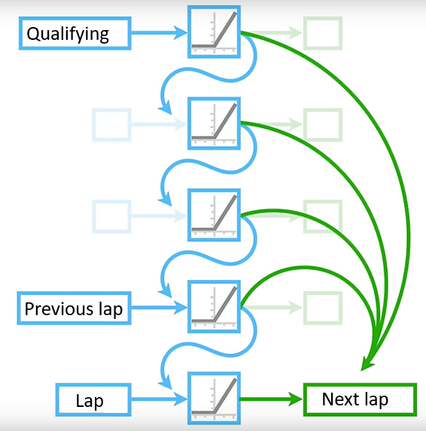
How LSTM works
The principle

Slide 13
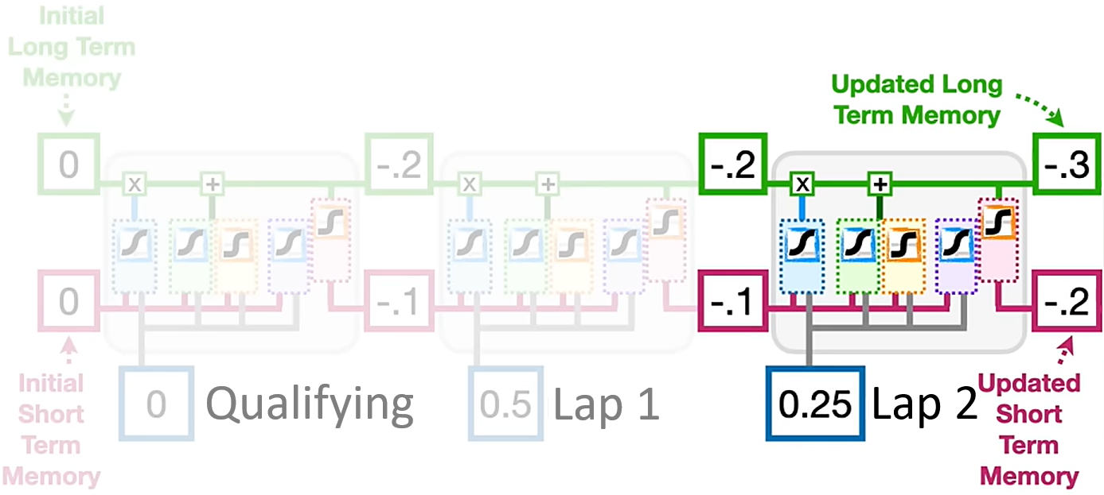
How LSTM works
A bit of details

Slide 14
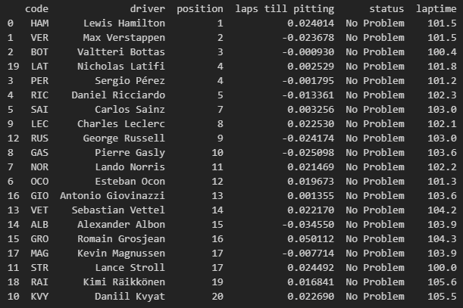
Raw result sample

Slide 15
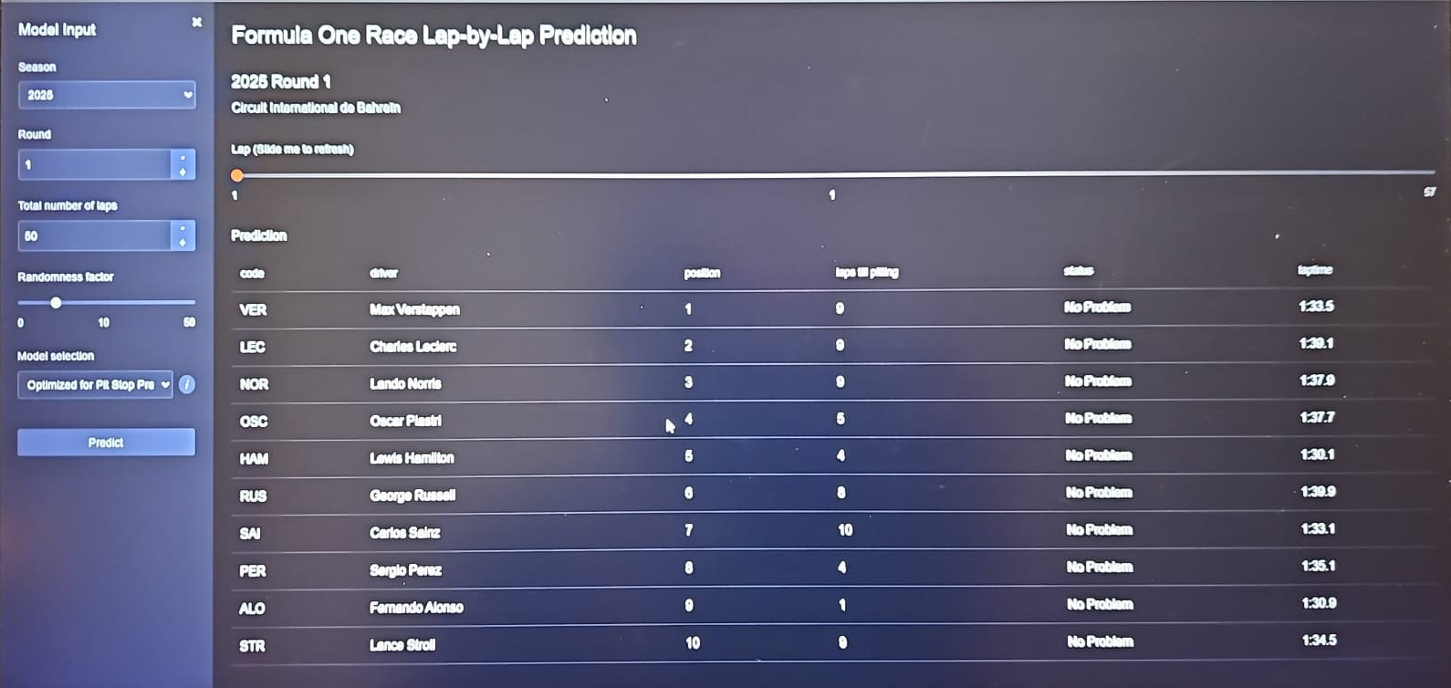
User Interface (WIP)

Slide 16
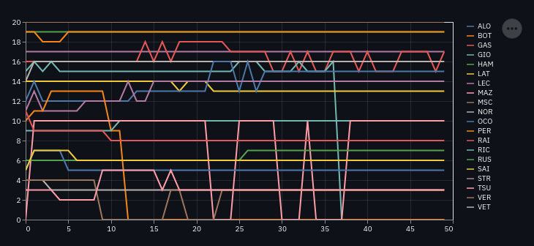
Future result layout

Slide 17
Future features
→ Integrate weather, tyre compounds, track surface data.
→ Model fuel‐weight impact when regulations change.
→ Explore Transformer-based architectures for improved long‑term modeling.

